Slide 1
Intention Propagation for Multi-agent Reinforcement Learning
Literature review 12

Slide 2
Contents
1
Motivation
2
Methodology

Slide 3
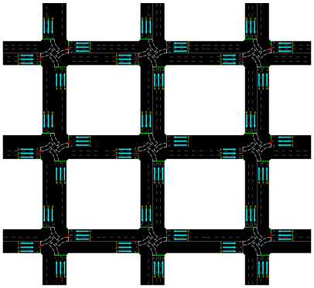

1 Motivation
Research problem
There is a surge of interest in solving the collaborative MARL problem.
Joint policy approaches have demonstrated superiority

Slide 4






1 Motivation
Research problem
There is a surge of interest in solving the collaborative MARL problem.
Joint policy approaches have demonstrated superiority
$$a_{1}$$
$$a_{1}$$
$$a_{2}$$
$$a_{3}$$
$$a_{2}$$
$$a_{3}$$
Agent 1
Agent 3
Agent
Agent 2
Agents’ observation may interact with each other, and the action may affect each other
The simplest form is that one agent produce all actions on its own.

Slide 5
1 Motivation
Research problem
There is a surge of interest in solving the collaborative MARL problem.
Joint policy approaches have demonstrated superiority
$$a_{1}$$
$$a_{1}$$
$$a_{2}$$
$$a_{3}$$
$$a_{2}$$
$$a_{3}$$
Agent 1
Agent 3
Agent
Agent 2
Agents’ observation may interact with each other, and the action may affect each other
The simplest form is that one agent produce all actions on its own.
Notes:
Action space will explode as number of agents increase

Slide 6
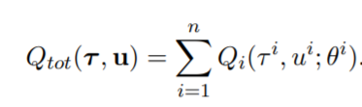







1 Motivation
Research problem
There is a surge of interest in solving the collaborative MARL problem.
Joint policy approaches have demonstrated superiority
Factorization on policy
Factorization on value function
$$a_{1}$$
$$a_{1}$$
$$a_{2}$$
$$a_{2}$$
$$a_{3}$$
$$a_{3}$$
Agent 1
Agent 1
Agent 3
Agent 2
Agent 2
$$π\left(a | s\right)=\prod_{i=0}^{N}{π_{i}(a_{i}|s)}$$
Agents’ polices are independent
Agents’ evaluation are independent
Notes:
Action space will explode as number of agents increase

Slide 7
1 Motivation
Research problem
There is a surge of interest in solving the collaborative MARL problem.
Joint policy approaches have demonstrated superiority
Factorization on policy
Factorization on value function
$$a_{1}$$
$$a_{1}$$
Few of them consider interactions between agents
$$a_{2}$$
$$a_{2}$$
$$a_{3}$$
$$a_{3}$$
Such consideration is only applied in discrete action case
Agent 1
Agent 1
Agent 3
Agent 2
Agent 2
$$π\left(a | s\right)=\prod_{i=0}^{N}{π_{i}(a_{i}|s)}$$
Agents’ polices are independent
Agents’ evaluation are independent
Notes:
Action space will explode as number of agents increase

Slide 8
1 Motivation
Research problem
There is a surge of interest in solving the collaborative MARL problem.
Joint policy approaches have demonstrated superiority
Basic intuition
Humans can reason about other’s behaviors or know other peoples’ intentions through communication and then determine an effective coordination plan.

Slide 9
1 Motivation
Research problem
There is a surge of interest in solving the collaborative MARL problem.
Joint policy approaches have demonstrated superiority
Basic intuition
Humans can reason about other’s behaviors or know other peoples’ intentions through communication and then determine an effective coordination plan.
Major challenge
How to design a mechanism of such interaction in a principled way and at the same time solve the large scale real-world applications is still a challenging problem.

Slide 10

2 Methodology
Basics
$$s^{0}$$

Slide 11


2 Methodology
Basics
$$s^{0}$$
$$a^{0}$$
$$s^{1}$$

Slide 12


2 Methodology
Basics
$$s^{0}$$
$$a^{0}$$
$$s^{1}$$
$$a^{1}$$
Trajectory

Slide 13
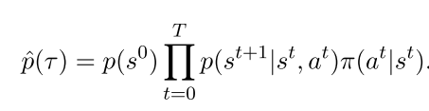
2 Methodology
Basics
$$s^{0}$$
$$a^{0}$$
$$s^{1}$$
$$a^{1}$$
Trajectory
Probability of such trajectory followed policy $π$

Slide 14




2 Methodology
Basics
$$s^{0}$$
$$a^{0}$$
$$s^{1}$$
$$a^{1}$$
Trajectory
$$O^{0}$$
$$O^{1}$$
$$O^{T}$$
Introduce additional variable O to indicate whether current step is optimal step, and related probability can be modelled using reward signal:

Slide 15
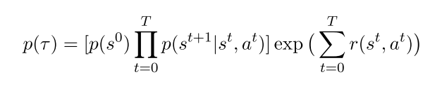
2 Methodology
Basics
$$s^{0}$$
$$a^{0}$$
$$s^{1}$$
$$a^{1}$$
Trajectory
$$O^{0}$$
$$O^{1}$$
$$O^{T}$$
Probability of such trajectory followed optimal policy

Slide 16
2 Methodology
Basics
$$s^{0}$$
$$a^{0}$$
$$s^{1}$$
$$a^{1}$$
Trajectory
$$O^{0}$$
$$O^{1}$$
$$O^{T}$$
Objective: minimize kl-divergence between these two distributions

Slide 17
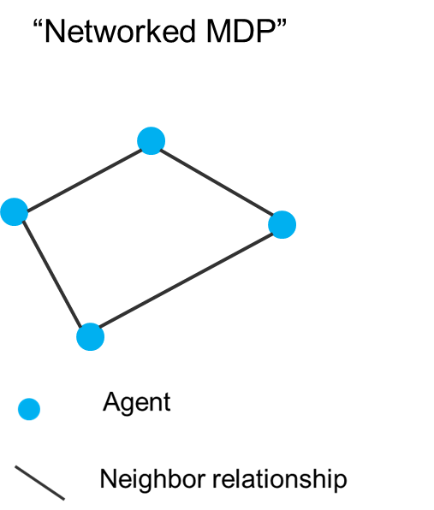
2 Methodology
The proposed method (what is optimal policy)

Slide 18

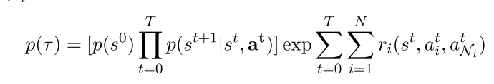
2 Methodology
The proposed method (what is optimal policy)
Reward of each agent depends on its own state and action, as well as actions of its neighbors

Slide 19
2 Methodology
The proposed method (what is optimal policy)
Reward of each agent depends on its own state and action, as well as actions of its neighbors

Slide 20
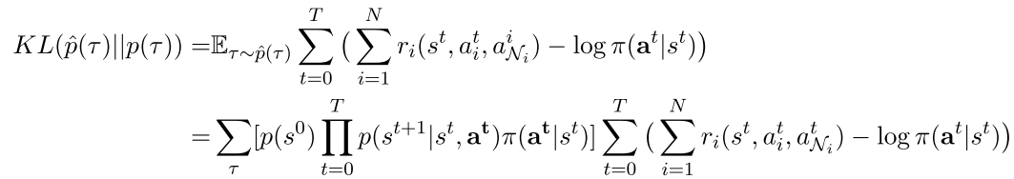
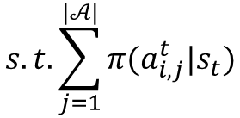
2 Methodology
The proposed method (what is optimal policy)

Slide 21
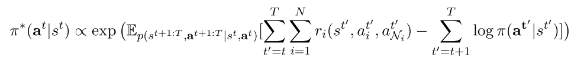
2 Methodology
The proposed method (what is optimal policy)
Minimization problem with constraint (Solution: Lagrangian multiplier)

Slide 22
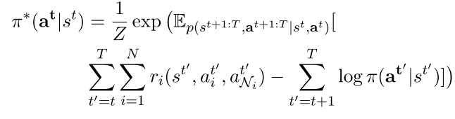
2 Methodology
The proposed method (what is optimal policy)
Normalization by Z

Slide 23
2 Methodology
The proposed method (what is optimal policy)
The optimal policy is in the form of Markov random Field, and each agent is only affected by the its direct neighbors, thus can reduce policy space to search. (Compared to fully connected graph)

Slide 24
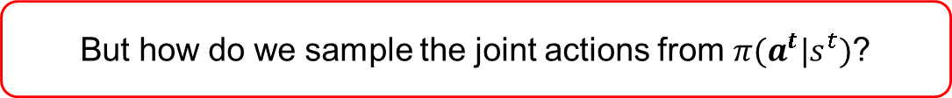
2 Methodology
The proposed method (what is optimal policy)
But how do we sample the joint actions from $π(a^{t}|s^{t})$?
The optimal policy is in the form of Markov random Field, and each agent is only affected by the its direct neighbors, thus can reduce policy space to search. (Compared to fully connected graph)

Slide 25
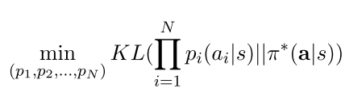

2 Methodology
The proposed method (How to sample joint actions from MRF policy)
Approximate optimal policy through mean field approximation
Problem
Solution

Slide 26
2 Methodology
The proposed method (How to sample joint actions from MRF policy)
Approximate optimal policy through mean field approximation
Problem
Solution via Variational Inference

Slide 27
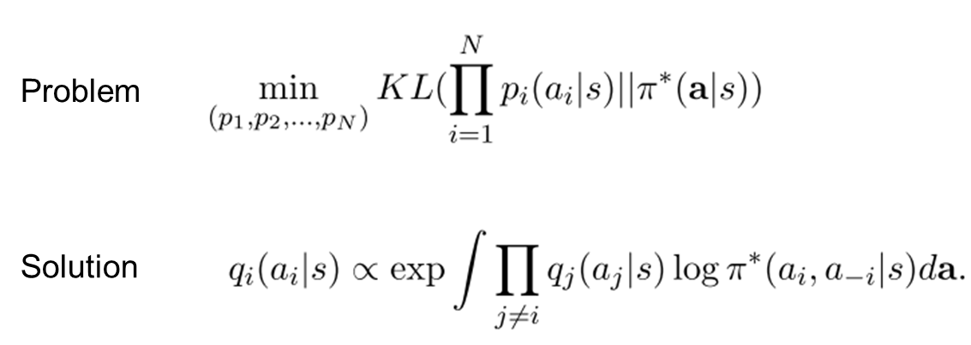
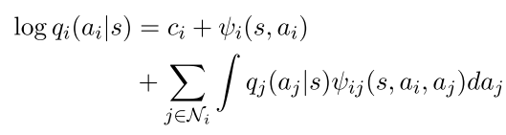

2 Methodology
The proposed method (How to sample joint actions from MRF policy)
$$a_{−i}$$
Consider the pair-wise case ( Restrict parametrization on edge)

Slide 28
2 Methodology
The proposed method (How to sample joint actions from MRF policy)
$$a_{−i}$$
Consider the pair-wise case ( Restrict parametrization on edge)
Agent’s policy depends on others

Slide 29
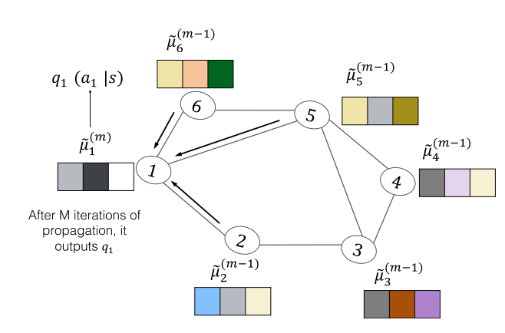
2 Methodology
The proposed method (How to perform update in algorithm)
● Model the policy
Policies of all the agents are modelled in one single neural network (named as intention network), or as a MRF framework.

Slide 30


2 Methodology
The proposed method (How to perform update in algorithm)
● Model the policy
1) Model policy feature based on state and other policies
2) From policy feature (input) to policy distribution.

Slide 31
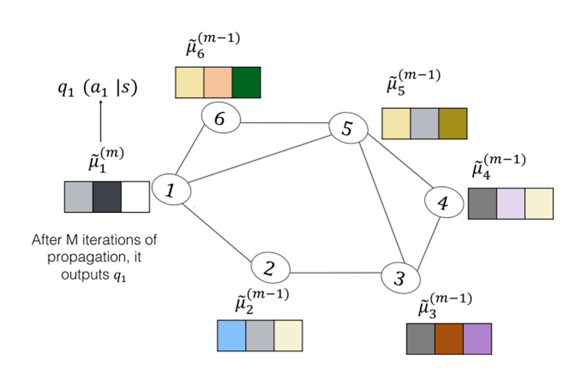
2 Methodology
The proposed method (How to perform update in algorithm)
At each step, M iteration needs to be implemented in order to perform intention propagation
Iteration 0:
Agents embed policy without knowledge on plans from other agents.

Slide 32
2 Methodology
The proposed method (How to perform update in algorithm)
At each step, M iteration needs to be implemented in order to perform intention propagation
Iteration 1-M:
Agents sample actions without knowledge on plans from other agents.

Slide 33
2 Methodology
The proposed method (How to perform update in algorithm)
At each step, M iteration needs to be implemented in order to perform intention propagation
Iteration 1-M:
Agents sample actions without knowledge on plans from other agents.
The number of iterations is small.
( But how to determine such a number?)

Slide 34
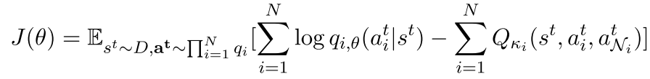
2 Methodology
The proposed method (How to perform update in algorithm)
Loss function for state value estimation
Loss function for state-action value function
Loss function for policy

Slide 35
Thank you for watching !

